Slide 1
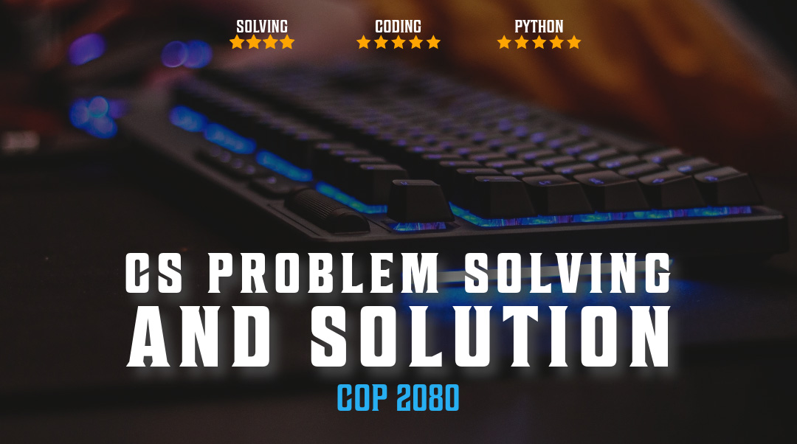

Data types and Structures

Slide 2
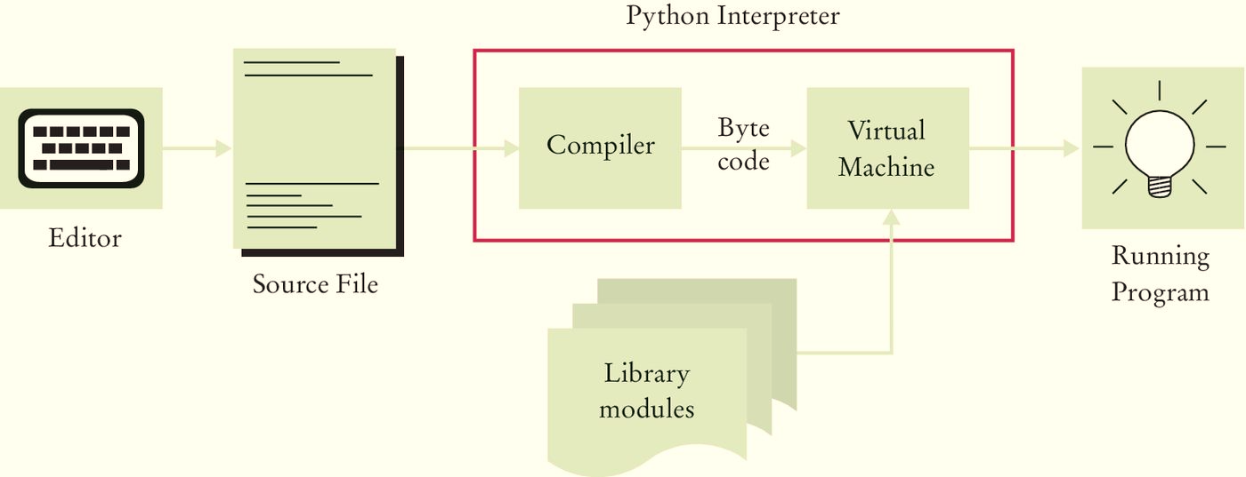
Running a Python Program
The compiler generates byte code instructions (instructions for the Python Virtual machine)
  The Virtual machine is a program that is similar to the CPU of your computer
  Any necessary libraries (e.g. for drawing graphics) are automatically located and included by the virtual machine

Slide 3
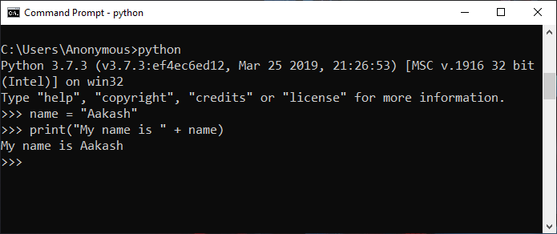
Python Interactive Shell
Write/save a complete Python program in a file and let the Python interpreter execute the instructions all at once.
Or run instructions one at a time using interactive mode.
  It allows quick ‘test programs’ to be written.
Interactive mode can be started typing ‘python’ at the cmd prompt.

Slide 4
"Data! Data! Data!" he cried impatiently. "I can't make bricks without clay."
– Sherlock Holmes, in The Adventure of the Copper Beeches
Everything you do with a computer is managing data.

Slide 5
C vs Python
Variables are best thought of as containers or buckets into which you put data
// C code
int x = 4;
In Python you are defining a variable in a namespace named x that points to some other bucket containing the value 4. This is not a C pointer.
# python code
X = 4

Slide 6
Python Data Model = Everything an object
Objects are Python’s abstraction for data
All data in a Python program is represented by objects or by relations between objects
Two main features of objects are they have properties and methods
Objects get IDs
Object: chicken
Property: white (color) ← characteristic of object
Method: clucks ← things the object can do

Slide 7

Everything is an object
Python has data types; the types are linked to the objects themselves.
Every entity has metadata (called attributes) and associated functionality (called methods).
The attributes and methods are accessed via the dot syntax.
Such as x = 5 x.append
Check some data types:

Slide 8
Immuatable – the value cannot change
>>> age = 42
>>> age
42
>>> age = 43 #A
>>> age
43
Did the value change?

Slide 9
Really Immutable
>>> age = 42
>>> id(age)
4377553168
>>> age = 43
>>> id(age)
4377553200
What do you get with id(43) ?

Slide 10
Integers as immutable objects
Python integers have an unlimited range, subject only to the available virtual memory.
Integer numbers can be positive, negative, or 0 (zero).
truncate a number to an integer,
you can use the built-in int() function
Notice that the truncation is done
toward 0.
>>> a = 14
>>> b = 3
>>> a + b # addition
17
>>> a * b # multiplication
>>> int(1.75)
1
>>> int(-1.75)
-1
>>> int('10110', base=2)

Slide 11
Boolean
>>> int(True) # True behaves like 1
1
>>> int(False) # False behaves like 0
0
>>> bool(1) # 1 evaluates to True in a Boolean context
True
>>> bool(-42) # and so does every non-zero number
True
>>> bool(0) # 0 evaluates to False
False
>>> not True
False
>>> not False
True
>>> True and True
True
>>> False or True
True
True and False are two keywords that are used to represent truth values. Booleans are a subclass of integers, so True and False behave respectively like 1 and 0.
Boolean values can be combined in Boolean expressions using the logical operators and, or, and not.

Slide 12

Floating point numbers
Floating point numbers are according to the IEEE 754 double-precision binary floating point format, which is stored in 64 bits of information divided into three sections: sign, exponent, and mantissa.
Similar to Double precision in other languages
Numbers suffer from approximation issues with simple values

Slide 13
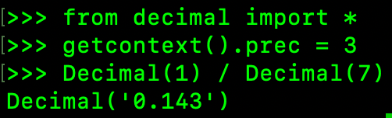
Decimal
The decimal module provides support for fast correctly rounded decimal floating point arithmetic
Decimal “is based on a floating-point model which was designed with people in mind
Arbitrary precision decimal numbers come at a price in terms of performance
Unlike hardware based binary floating point, the decimal module has a user alterable precision (defaulting to 28 places)

Slide 14
Strings and Bytes
>>> str1 = 'This is a string.'
>>> str2 = "This is also a string"
>>> str3 = '''This is built with,
... so it can span multiple lines.'’’
>>> str4 = """This too
... is a multiline""”
>>> str4 #A
'This too\nis a multiline’
>>> print(str4)
This too
is a multiline
Textual data in Python is handled with str objects, more commonly known as strings
Strings are immutable sequences of Unicode code points such as characters or formatting
Written using single, double, or triple quotes (double)

Slide 15

PEP 8 Guidelines for string quotes
In Python, single-quoted strings and double-quoted strings are the same. This PEP does not make a recommendation for this. Pick a rule and stick to it. When a string contains single or double quote characters, however, use the other one to avoid backslashes in the string. It improves readability.

Slide 16
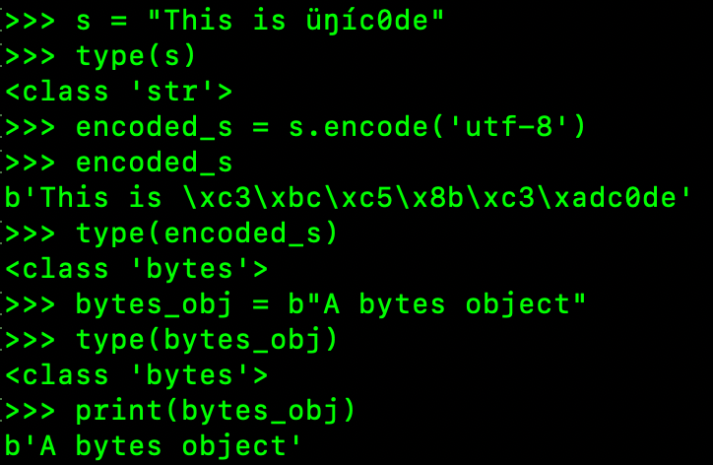
Encoding and Decoding
Using the encode/decode methods, we can encode Unicode strings and decode bytes objects. UTF-8 is a variable-length character encoding, capable of encoding all possible Unicode code points. It is the most widely used encoding for the web.
Notice that by adding the literal b in front of a string declaration, creates a bytes object:

Slide 17
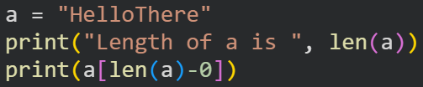
Fetching the last element in a collection
What would the following result in?
Should the last line include -10 instead of -0 to retrieve the last character?
Which is a better choice to use: positive indexing or negative indexing?

Slide 18
Indexing and Slicing
>>> s = "The trouble is you think you have time."
>>> s[0] # indexing at position 0
'T'
>>> s[5] # indexing at position 5
'r'
>>> s[:4] # slicing, only the stop position
'The '
>>> s[4:] # slicing, only the start position
'trouble is you think you have time.'
>>> s[2:14] # slicing, both start and stop
'e trouble is'
>>> s[2:14:3] # start, stop and step (every 3 chars)
'erb ‘
Zero-based access to any position within the sequence via index
Specify the start and stop positions, along with the step
All the arguments are optional; start is inclusive, and stop is exclusive

Slide 19
Tuples are immutable
Sequence of arbitrary Python objects
Items are separated by commas
Can be used to allow a function to return multiple objects
Can print multiple elements with one single instruction
>>> t = () # empty tuple
>>> type(t)
<class 'tuple'>
>>> one_element_tuple = (42, ) # you need the comma!
>>> three_elements_tuple = (1, 3, 5) # Parentheses are optional
>>> a, b, c = 1, 2, 3 # tuple for multiple assignment
>>> a, b, c # implicit tuple to print with one instruction
(1, 2, 3)
>>> 3 in three_elements_tuple # membership test
True

Slide 20
Lists are mutable sequences
Used to store collections of objects
>>> [] # empty list
[]
>>> list() # same as []
[]
>>> [1, 2, 3] # as with tuples, items are comma separated
[1, 2, 3]
>>> [x + 5 for x in [2, 3, 4]] # Python is magic
[7, 8, 9]
>>> list((1, 3, 5, 7, 9)) # list from a tuple
[1, 3, 5, 7, 9]
>>> list('hello') # list from a string
['h', 'e', 'l', 'l', 'o']

Slide 21
Manipulating Lists
>>> a = [1, 2, 1, 3]
>>> a.append(13) # append anything at the end
>>> a
[1, 2, 1, 3, 13]
>>> a.count(1) # how many `1s` a in the list?
2
>>> a.extend([5, 7]) # extend by another (or seq)
>>> a
[1, 2, 1, 3, 13, 5, 7]
>>> a.index(13) # position of `13`
4
>>> a.insert(0, 17) # insert `17` at position 0
>>> a
[17, 1, 2, 1, 3, 13, 5, 7]
>>> a.pop() # pop (remove and return) last element
7
>>> a.pop(3) # pop element at position 3
1
>>> a
[17, 1, 2, 3, 13, 5]
>>> a.remove(17) # remove `17` from the list
>>> a
[1, 2, 3, 13, 5]
>>> a.reverse() # reverse the order of the elements
>>> a
[5, 13, 3, 2, 1]
>>> a.sort() # sort the list
>>> a
[1, 2, 3, 5, 13]
>>> a.clear() # remove all elements from the list
>>> a
[]

Slide 22

Other List methods
>>> a = list('hello') # makes a list from a string
>>> a
['h', 'e', 'l', 'l', 'o']
>>> a.append(100) # append 100, heterogeneous type
>>> a
['h', 'e', 'l', 'l', 'o', 100]
>>> a.extend((1, 2, 3)) # extend using tuple
>>> a
['h', 'e', 'l', 'l', 'o', 100, 1, 2, 3]
>>> a.extend('...') # extend using string
>>> a
['h', 'e', 'l', 'l', 'o', 100, 1, 2, 3, '.', '.', '.']

Slide 23

PEP 8 Guidelines for naming
Function and Variable Names
Function names should be lowercase, with words separated by underscores as necessary to improve readability.
Variable names follow the same convention as function names.

Slide 24
Mapping type: Dictionaries (mutable)
Maps keys to values.
Keys need to be hashable objects,
Values can be of any arbitrary type
Object is hashable if it has a hash value that does not change during its entire lifetime
Pair of braces creates an empty dictionary: {}
>>> a = dict(A=1, Z=-1)
>>> b = {'A': 1, 'Z': -1}
>>> c = dict(zip(['A', 'Z'], [1, -1]))
>>> d = dict([('A', 1), ('Z', -1)])
>>> e = dict({'Z': -1, 'A': 1})
>>> a == b == c == d == e # tests if same?
True # They are indeed

Slide 25

Zip
>>> list(zip(['h', 'e', 'l', 'l', 'o'], [1, 2, 3, 4, 5]))
[('h', 1), ('e', 2), ('l', 3), ('l', 4), ('o', 5)]
>>> list(zip('hello', range(1, 6))) # equivalent, more pythonic
[('h', 1), ('e', 2), ('l', 3), ('l', 4), ('o', 5)]
Zip function takes iterables (zero or more), aggregates them in a tuple, and returns it
The list() constructor around the zip() call
zip() returns an iterator, not a list() constructor around the zip() call
Zip couples the elements together

Slide 26

Square bracket for Dictionary Key
>>> d = {}
>>> d['a'] = 1 # let's set a couple of (key, value) pairs
>>> d['b'] = 2
>>> len(d) # how many pairs?
2
>>> d['a'] # what is the value of 'a'?
1
>>> d # view d
{'a': 1, 'b': 2}
>>> del d['a'] # remove `a`
>>> d
{'b': 2}
>>> d['c'] = 3 # add 'c': 3
>>> 'c' in d # membership is checked against the keys
True
>>> 3 in d # not the values
False
>>> 'e' in d
False
>>> d.clear() # clean up dictionary
>>> d
{}

Slide 27
Intentionally blank
blank

Slide 28
Collections
List is a collection which is ordered and changeable. Allows duplicate members. mylist = ["apple", "banana", "cherry"]
Tuple is a collection which is ordered and unchangeable. Allows duplicate members. mytuple = ("apple", "banana", "cherry")
Set is a collection which is unordered, unchangeable, and unindexed. No duplicate members. myset = {"apple", "banana", "cherry"}
Dictionary is a collection which is ordered and changeable. No duplicate members. thisdict = { “brand”: “Honda”,”model”: ”CRV","year": 2018}

Slide 29

Summary
Explored the built-in data types and data structures
Learned the difference between mutable and immutable
Understand slicing and indexing

